Slide 1
International Islamic University Chittagong
ABOUT
BUDGET
PROJECT
TIMELINE
Department of Computer Science & engineering
Course Code: CSE-3532
Course Tittle: Tools and Technologies for Internet Programming
Submitted To: Mrs. Atia Binti Aziz
Adjunct Faculty,
Dept. Of CSE,IIUC.
PROJECT PROPOSAL

Slide 2
PREPARED BY
ABOUT
BUDGET
PROJECT
TIMELINE
Name : Kanita Haider
ID : C201216
Semester : 5th
Section : 5AF
PROJECT PROPOSAL

Slide 3

A project Proposal On E-Commerce Web Application
ABOUT
BUDGET
PROJECT
TIMELINE
PROJECT PROPOSAL

Slide 4
INTRUDUCTION
PROBLEM STATEMENT
TABLE OF CONTENTS
PROJECT OBJECTIVE
FEATURES
ABOUT
BUDGET
PROJECT
TIMELINE
01
02
03
04
PROJECT PROPOSAL

Slide 5
REQUIREMENTS
TABLE OF CONTENTS
FEATURE BASED OUTCOMES
ABOUT
BUDGET
PROJECT
TIMELINE
05
06
PROJECT PROPOSAL

Slide 6
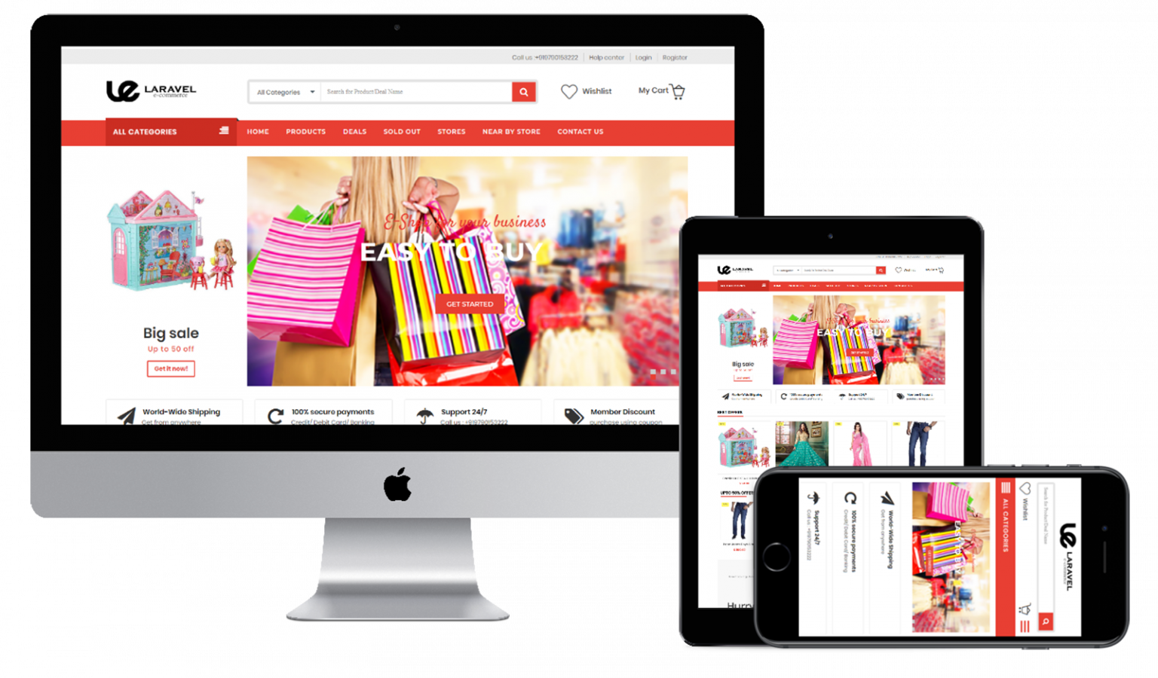
Intruduction
INTRUDUCTION
FEATURES
PROJECT
TIMELINE
01
Buying and selling of products on online service or over the internet is called e-commerce, and people who do it are commers.
PROJECT PROPOSAL

Slide 7
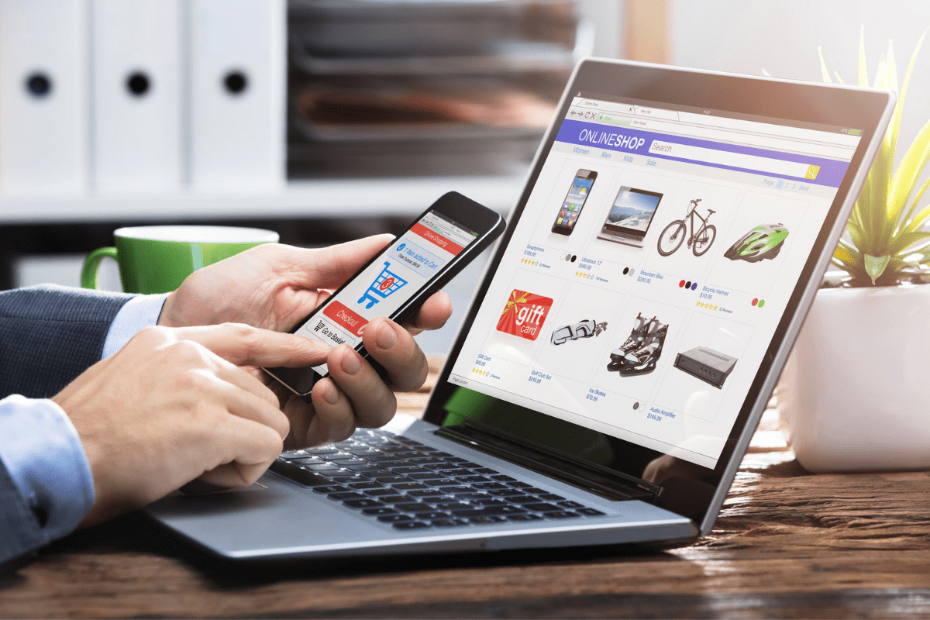
ABOUT
BUDGET
PROJECT
TIMELINE
Online shopping is a platform that embraces technology and at the same time incorporates the various needs of a people to enable them shop at their comfort.
I am doing an e-commerce online store call shop.qanita.bd.
Types of Users of the website are:
• Visitors
• Customers ( Registered Member )
• Admin
PROJECT PROPOSAL

Slide 8

PROBLEM STATEMENT
ABOUT
BUDGET
PROJECT
TIMELINE
02
PROJECT PROPOSAL

Slide 9
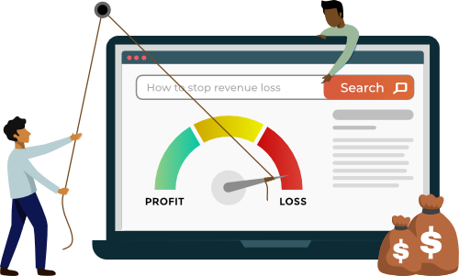
PROBLEM STATEMENT
ABOUT
BUDGET
PROJECT
TIMELINE
Current e-commerce online shops do not meet individual’s specific needs, are less appealing to users and are limited to the communication.
They display a broad range of products and services to persons who may never be in need of them.
PROJECT PROPOSAL

Slide 10

Project objective
INTRUDUCTION
FEATURES
PROJECT
TIMELINE
03
To develop an online shop mall that will serve specific special needs of every customer
PROJECT PROPOSAL

Slide 11

Specific Objectives
Project
BUDGET
PROJECT
TIMELINE
1. View Home Banners or Slide Show Gallery
2. Browse Merchandises
3. View Product Details with ( HD Photos gallery, rapid climb, in and whizz out ) .
4. Become a Member through Registration procedure.
5. Add to cart
7. Payment.
9. Shipping
PROJECT PROPOSAL

Slide 12

Features
ABOUT
PROJECT
PROJECT
TIMELINE
04
PROJECT PROPOSAL

Slide 13
Visitor
Member
Admin
ABOUT
Featues
PROJECT
TIMELINE
• View Products
product Details
specification
Availability
• Gallery
• Zoom View
• Customer reappraisal
• Delivery Options.
• Login to site
• My Profile
• Manage Account
• My Orders
• Buy Product ( Checkout )
• Logout
Login
• Administrator User Management
• Product Attribute Management
• Product Management
• Price Chart Management
• Banner Manager
• Order Manager
• Shipping Management
PROJECT PROPOSAL

Slide 14

Requirements
ABOUT
PROJECT
PROJECT
TIMELINE
05
PROJECT PROPOSAL

Slide 15
Hardware Requirements
ABOUT
BUDGET
PROJECT
TIMELINE
Software
Requirements
Processor : i3 or Higher
RAM : 8GB
Hard Disk : 100GB
Speed : 2.4 GHz+
Operating System : Windows 7
or Higher
Coding Language : HTML, CSS, JavaScript, Jquery, Bootstrap
Back End : Php,Laravel,Mysql.
Application : VS Code,Canva.
PROJECT PROPOSAL

Slide 16
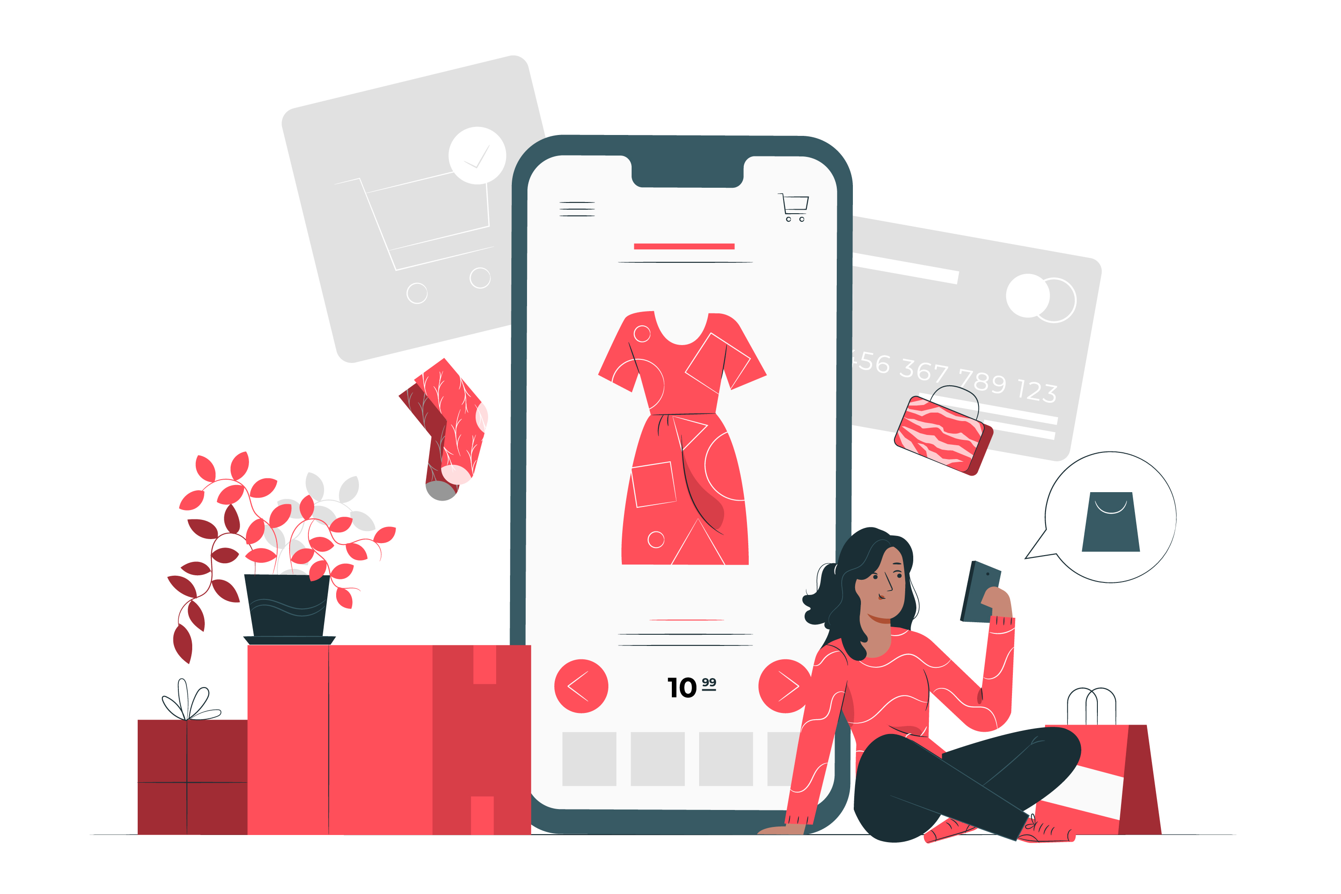
Feature Based Outcome
INTRUDUCTION
FEATURES
PROJECT
TIMELINE
06
PROJECT PROPOSAL

Slide 17
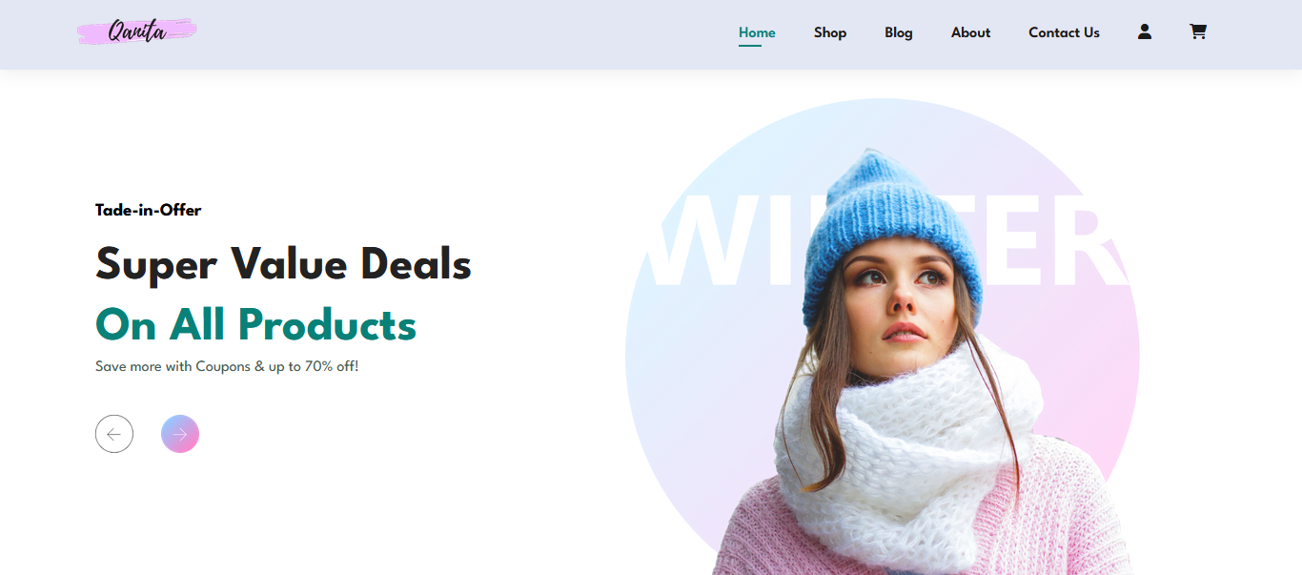
SNEAK PEEK
ABOUT
BUDGET
PROJECT
TIMELINE
To Visit the full website,
See the attached Files.
PROJECT PROPOSAL

Slide 18
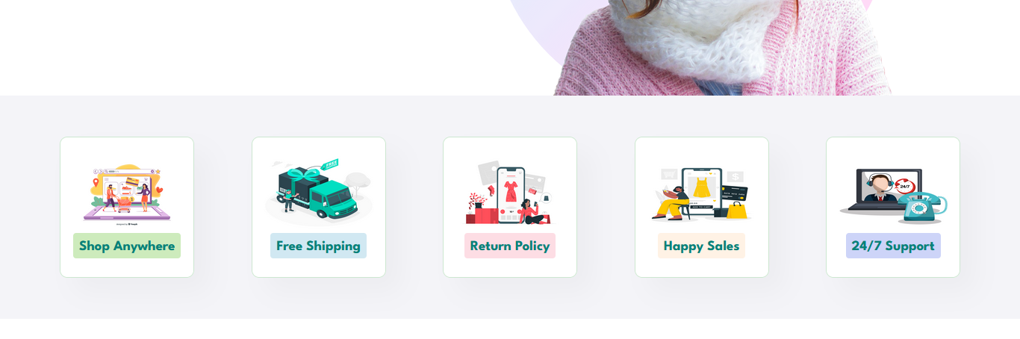

Slide 19
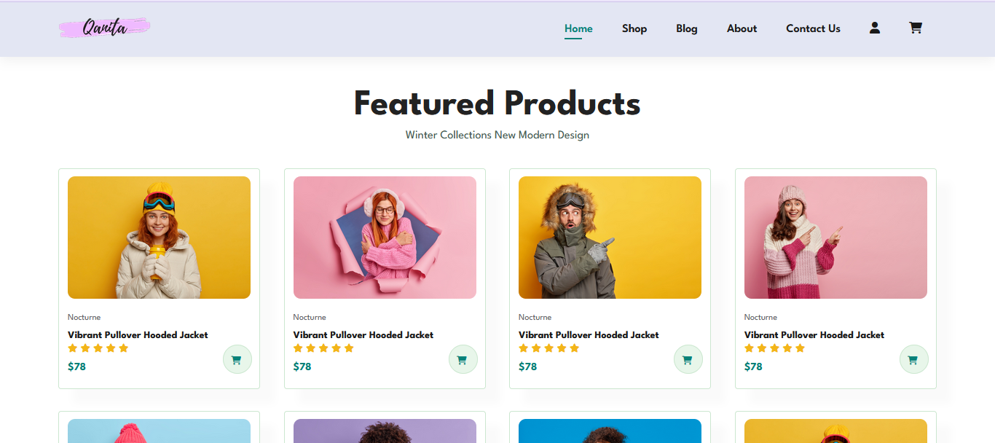
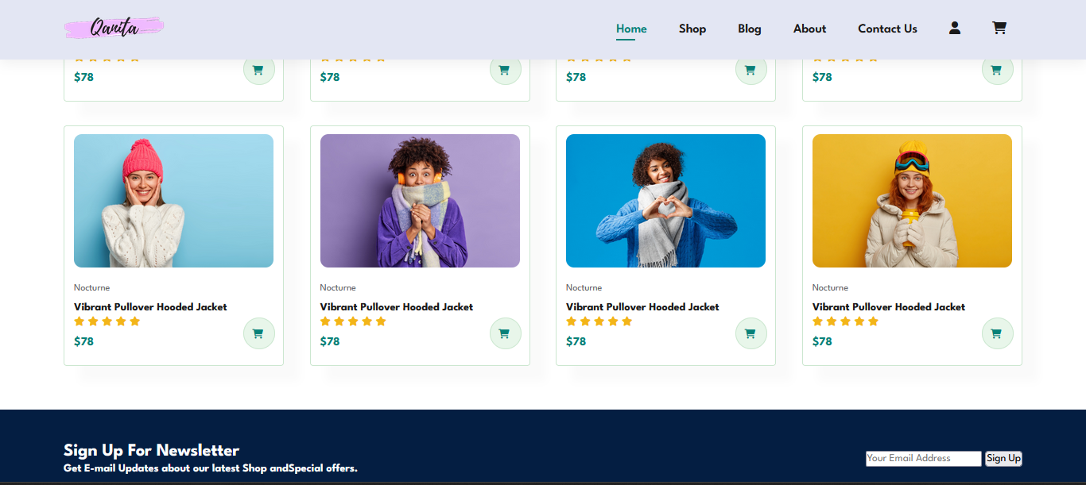

Slide 20
THANKS!
ABOUT
BUDGET
PROJECT
TIMELINE
Do you have any questions?
PROJECT PROPOSAL

